Slide 1


HCI
PROJECT
We care
Life is available to everyone

Slide 2
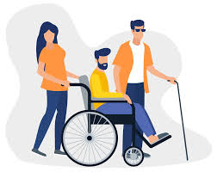
Problem Definition
Due to the difficulties faced by people with disabilities in obtaining their supplies, and their
lack of widespread availability in the markets, obtaining them may require traveling to other
countries .
…And not highlighting them in the desired way like other people .
Goals of Project
1_ Creating an integrated program that serves people with disabilities in multiple ways .
2_ Facilitating the smooth access of people with disabilities to their supplies, without the
need to search and travel .
3_ Providing a full medical staff to serve them and answer their inquiries .
4_ Providing a special section for donation, targeting cases whose financial level is low, such .
that they are unable to provide their requirements .

Slide 3

Persona
Primary user
Name: George mantea
Background
Date Of Birth: 03/25/1970
Gender: Male
Location: Romania
Work place: ”Coltea“Clinical Hospital, Medic Detailed Deception
School: "Carol Davila
Main Points
George Mantia is an orthopedic doctor and also runs rehabilitation courses for the disabled
He is 42 years old and graduated from the Carol Davila University of Medicine and Pharmacy.
He knows how to use a computer, so he did not have difficulty using the application, working with it, and posting inquiries in it
The application does not have to be written in Arabic, it is only fluent in English
George Mantia is a 42-year-old man who has been practicing medicine
for over 15 years. After graduating from Carol Davila University of Medicine and Pharmacy, he
specifically knew that he would specialize in orthopedics.
. Being a very serious person, he managed to be the first to get the major in the final exam.
His mother, Mary, was diagnosed with Reiter's Syndrome.
He chose to learn and discover more details about this disease. By doing this, he began to
quickly learn and understand everything related to orthopedics

Slide 4

Secondary User
Name: Reem
Background
Date Of Birth: 06/25/2003Gender: Male
Location: Hadhramaut Governorate, Yemen
School: “almaref”
Detailed Deception
Reem, graduated from high school. She is 20 years old
She has been paralyzed since birth and cannot move her lower limbs
She faced many difficulties in her life because of her disability, and even education was not
easy for her
Reem discovered the application by chance, and benefited a lot from it.
She began visiting this application regularly, browsing it...and asking doctors about anything
related to her disability.

Slide 5
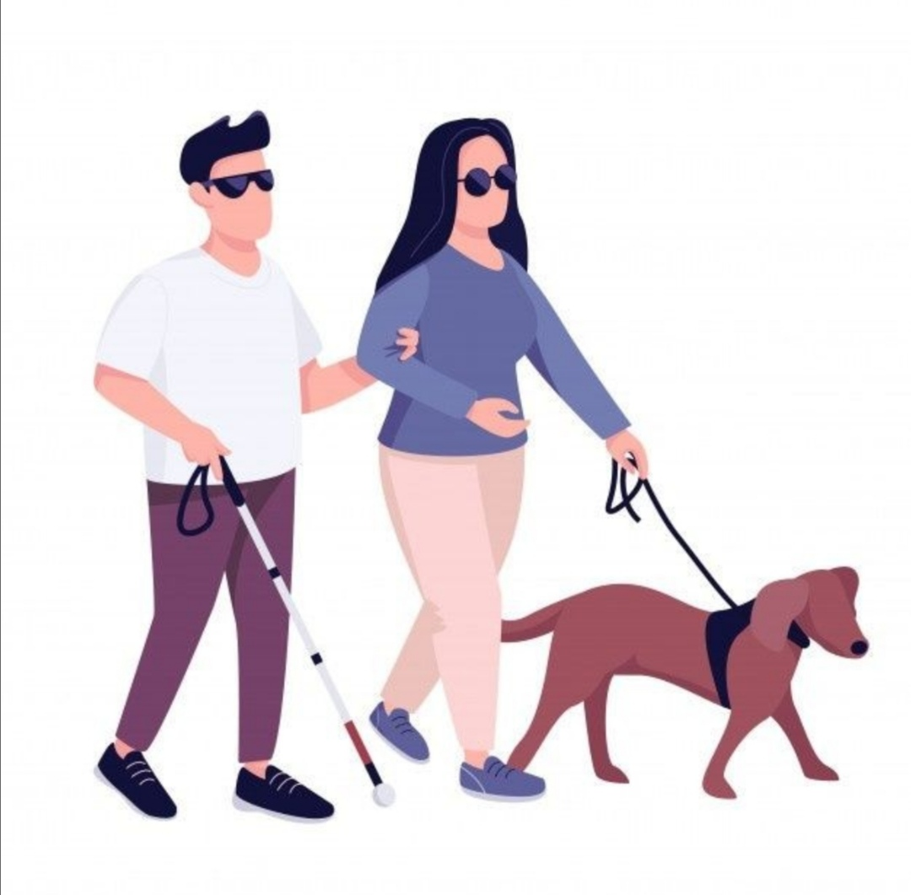
Functional Requirements
1_ Providing the necessary devices to meet the needs of the disabled
2_ Providing excellent medical staff
3_ Providing fast delivery service
4_ Contracting with a charitable organization to contribute to the donation process

Slide 6
Hierarchical Task Analysis (HTA)
0.0
Register or login
1.0
Go to the Application
2.0
Login using your username and password
3.0
Go to the home page and choose the page you need from the List
3.2.1
Motor Disability
4.0
Donation
3.1
The Doctors
3.2.2
Mental handicap
3.3.1
Discounts
3.2
Disabilities
3.2.3
Visual Disability
3.3.2
Favorite
3.3
The Shop
3.2.4
Down’s syndrome

Slide 7
Usability
Usability Measures
Learning:
Efficiency: Efficient in use, as it is fast and free of any defects, whether advertisements or comments
Remember: It is easy for a person to remember how to use it, as it is easy, simple and uncomplicated
Errors: It is easy to correct user errors, as he can easily change or modify any request
User Experience Goals
Useful: As it made it much easier for its users, and saved time for them
Satiafying: As it has won the admiration of most of those who use it, it provides all their requirements in
one place
Don’t be distracted by ads
Easy to learn, as it does not require experience in operating it, and anyone can use it

Slide 8

.
Scenarios
Scenario 1- I'm Reem, I'm 20 years old
I needed a high-end wheelchair, and I couldn't find what I needed anywhere near me...so they
told me I should look in another country.
Until I discovered the “We Care” application while browsing the Internet.
I found what I needed, along with a lot of other devices, medical advice, and supervisors
specialized in all cases of disability to answer all our inquiries...
It is an amazing application.

Slide 9
Scenario 2-
Muhammad: I need a high-quality prosthetic leg. Because my leg was
amputated, I cannot continue to live my life normally
Khaled: Did you not find a place that provides it for you?
Muhammad: No, I searched in all the areas around me, and it is difficult to provide these
devices
Khaled: Did you search the Internet? You may find an app that provides this for you
Muhammad: No, I have not thought about it. Well, I will search and maybe I will find something
useful
After several days...
Muhammad: I discovered an amazing application. It provides all the devices we need with the
best quality...it also contains a lot of instructions...and there is a rehabilitation staff specialized in
answering all our inquiries, and there is also a place for donations for cases that are unable to
provide their needs. .
Khaled: What is the name of this application?
Muhammad: "We care"
Khaled: It is truly a wonderful application, congratulations to you

Slide 10
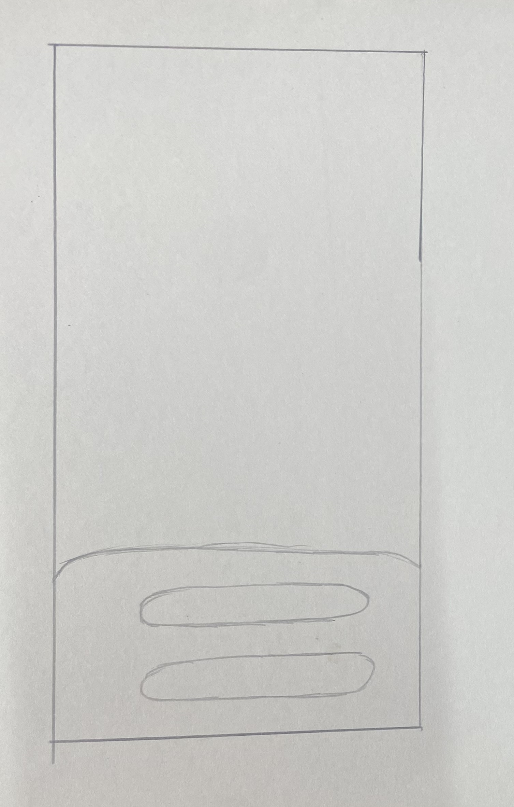
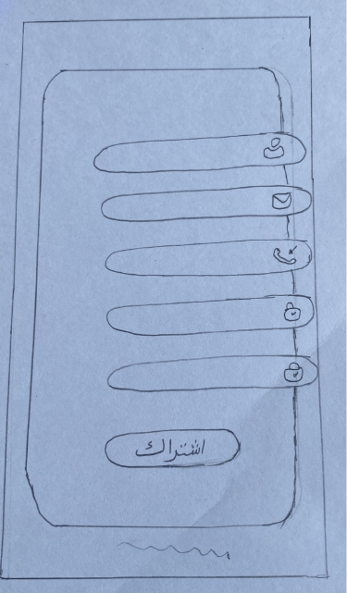
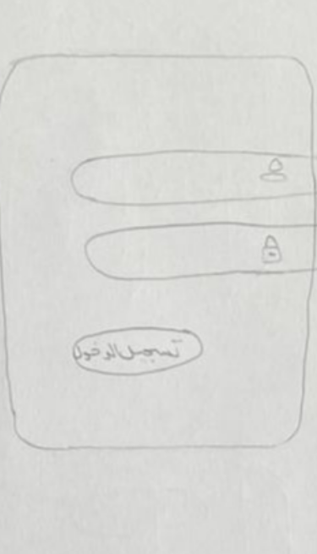
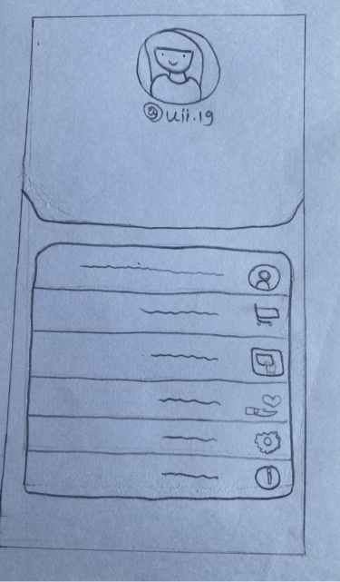
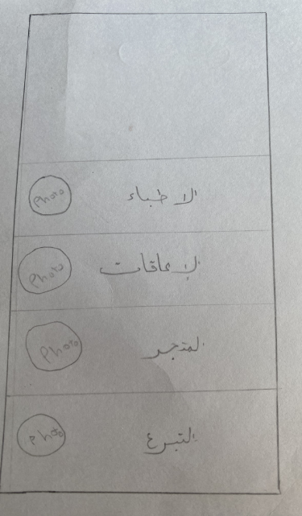
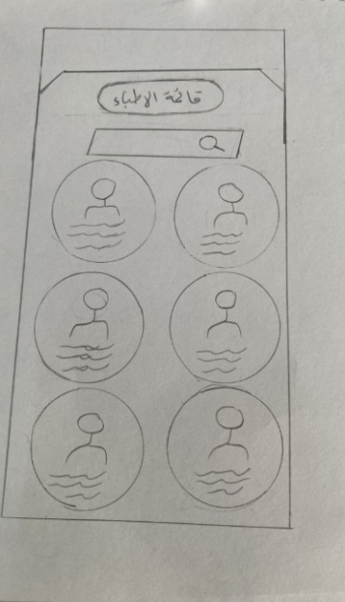
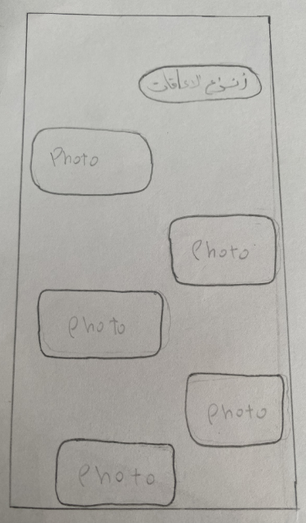
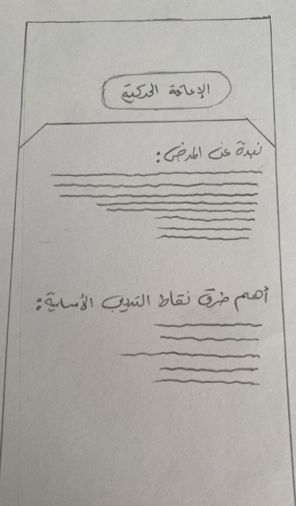
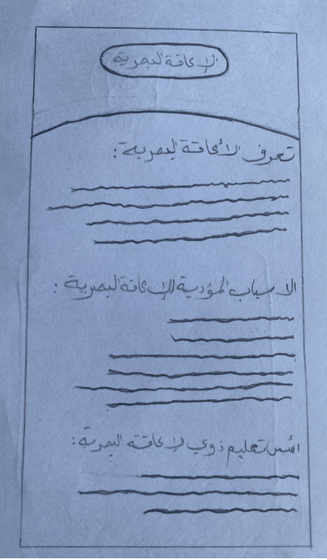
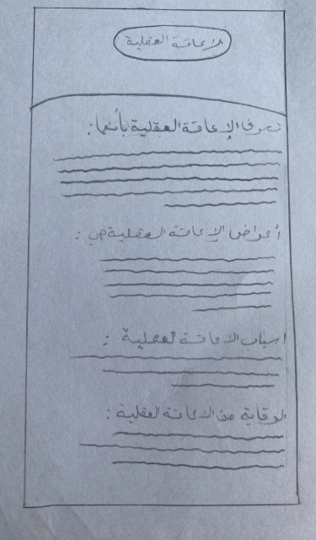
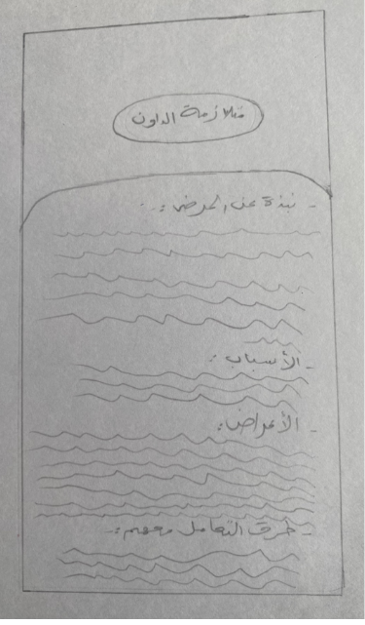
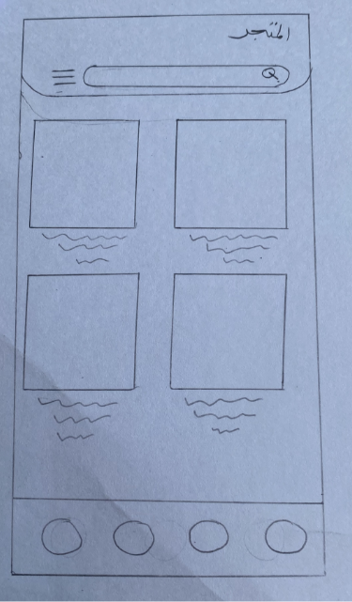
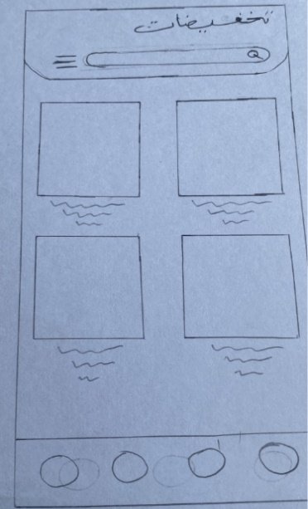
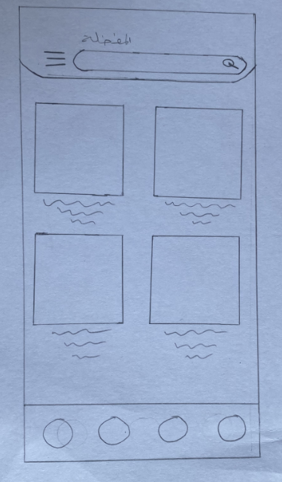
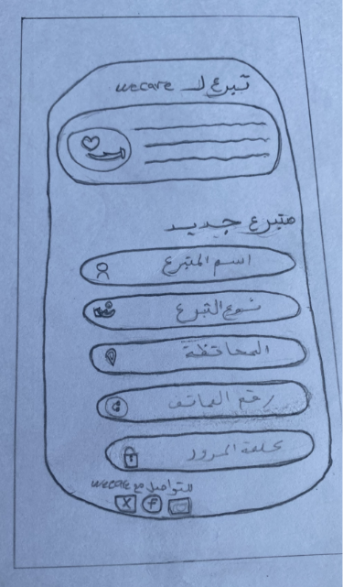
Sketch

Slide 11
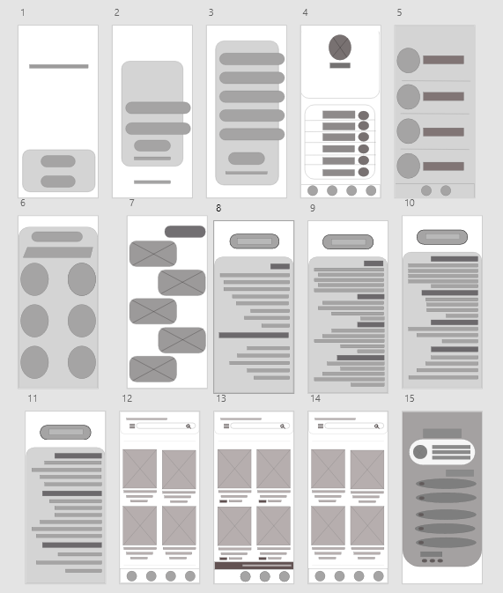
Wireframe

Slide 12
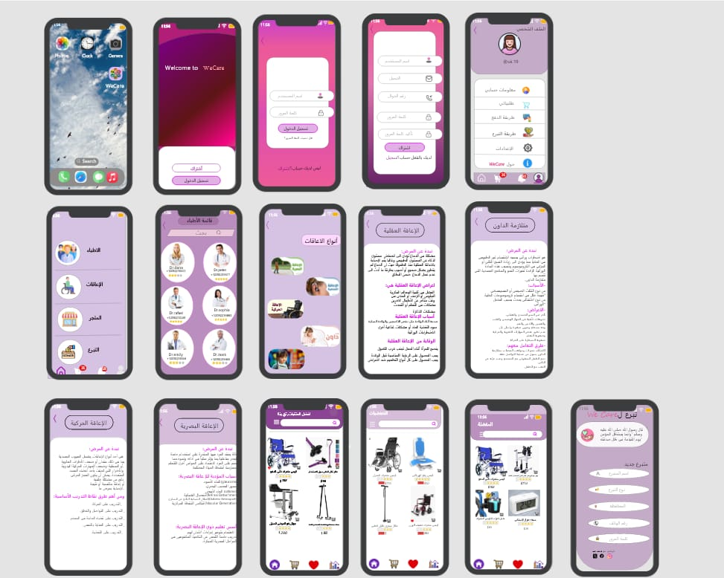
Mockup

Slide 13
wecare
Name of students in the project:
fatma ben ali alhajj
afnan alafif rawan suwaidan
alaa alawadi hafsa salah
اشراف:
Mr. Rami Aldhaibani

